Slide 1

IBM Project Presentation on
“Analysis and Detection of DDoS Attacks Using Machine Learning Techniques”
By G-07
Amin Yashvi MehulKumar 18162101001
Patel Henal Satishkumar 18162121018
Pandya Manush 18162171010
Under the guidance of
Prof. Aniket Patel
Mr. Ashwin Thandani

Slide 2
Table of Contents
Introduction
Objectives
Expected Outcome
Tools & Technology
Methodology (Modules)
Design / Diagrams & TimeLine Charts with Milestones
Implementations
Conclusion
Bibliography

Slide 3

A distributed denial of service (DDoS) attack is a malicious attempt to
disrupt normal traffic of a server, service, or network by overwhelming
the target or its surrounding infrastructure with a flood of internet
traffic.
DDoS attacks achieve effectiveness by utilizing many compromised computer systems as sources of attack traffic. Exploited machines can include computers and other networked resources such as IoT devices.
In a simple terms, a DDoS attack is like a traffic jam clogging up a highway, preventing regular traffic from arriving at its destination.

Slide 4

DDoS attacks are carried out with networks of Internet-
connected machines.
These networks consist of computers and other devices
(such as IOT devices)which have been infected with
malware, allowing them to be controlled remotely by
an attacker. These individual devices are referred to as bots
DDoS botnets are at the heart of every DDoS attack.
A botnet is a collection of hundreds or thousands of devices, known as zombies or bots
Once a botnet has been established, the attacker is able to direct an attack by sending remote instructions to each bot.
First, the cyber attacker takes control of the devices after infecting them with malware.
Once such a botnet has been created, specific instructions are given remotely to each bot in order for this to carry out an attack.
If the target is a network or web server, each bot sends requests to the server's IP address.
Without the owners' awareness, the devices might have been hacked by attackers who used security flaws and infected them with malware.

Slide 5
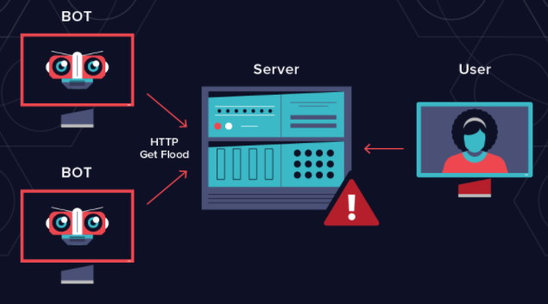

Slide 6
Introduction
A look into the recent attacks all over the world reveals that DDoS attacks have been on the rise. For any service provider website, DDoS attack is the most dangerous of all.
Loss of Service for any amount of time leads to huge losses in revenue, customer base and reputation.
Considering the given resources and project timeline we are creating a research based project where we explain and demonstrate various methods of DDoS mitigation techniques using open source tools and how to pair them with machine learning techniques to provide the most optimum security for a company deploying a web server.

Slide 7
Objectives
Creating a project where we explain and demonstrate various methods of DDoS mitigation techniques using open source tools and how to pair them with machine learning techniques to provide the most optimum security for a company deploying a web server.
To analyze data and its parameters to check any redundancy in data values that may affect prediction results.
To make a system which helps to detect and mitigate DDoS attacks by utilizing open source tools readily available on the market and using IBM Watson. The mitigation tools fetch the server request data and IBM Watson uses said data to analyze DDoS attack patterns and help the tools in enabling quicker detection process.
The main focus of this project is to utilize server request data and make effective use of this data in the analysis and automation of mitigation using various open source tools

Slide 8
Tools & Technology
For Windows
For Kali
LOIC
HOIC
PYLORIS
DDOSIM
RUDY
HYENAE
HULK
TORS HAMMER
SLOWLORIS
GOLDENEYE
HPING3

Slide 9
Other Tools
Ubuntu 20.04 OS for server
Apache for server environment
Graylog2 for log management
Wireshark & tcpdump for log collection
HAProxy for load balancing
DDOS Deflate for DDOS mitigation
IBM Watson for Machine learning
Jira for project management
Virtual Box

Slide 10
Methodology
Setup software on a VM Server.
Host a demo Web Application on the server
Perform Different Types of DDos Attacks on the web application using the different tools at various different configurations.
Performing Data filtration & Data visualization
Creating Models & deployment space in Watson Studio
Analyzing the Data & testing the Data

Slide 11
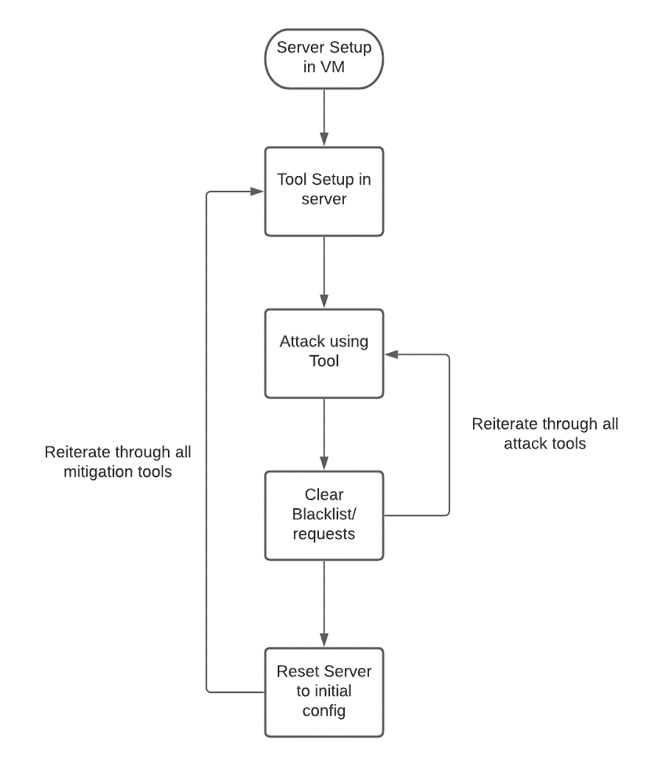
Flow Chart

Slide 12
Implementation
Searching for Open Source DDoS mitigation tools
The following tools are the most reputed and utilized open source ddos detection and mitigation tools.
- DDoS Deflate
- DDoSMon
- Fail2ban
- Fastnetmon
- HAProxy
Setup and Testing of DDoS mitigation tools
In this phase, we will setup and test the above tools under various conditions and test how well they respond against ddos attacks and which would be the best possible option.

Slide 13
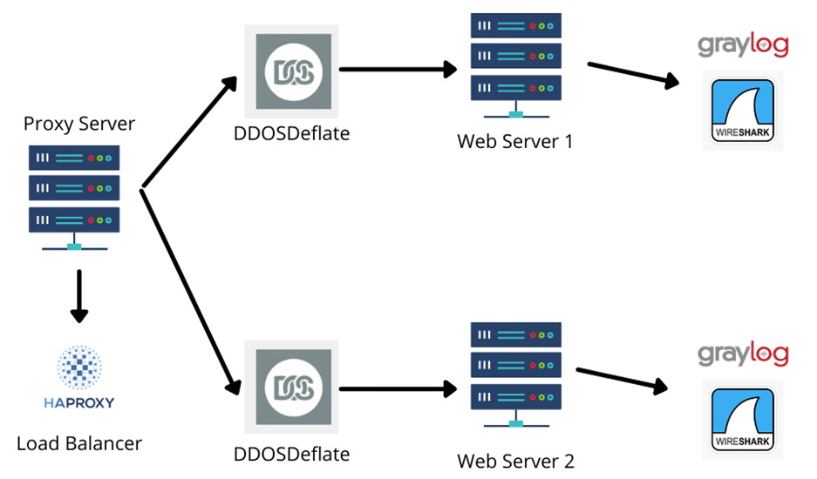

Slide 14

Demonstration Of Server Structure

Slide 15
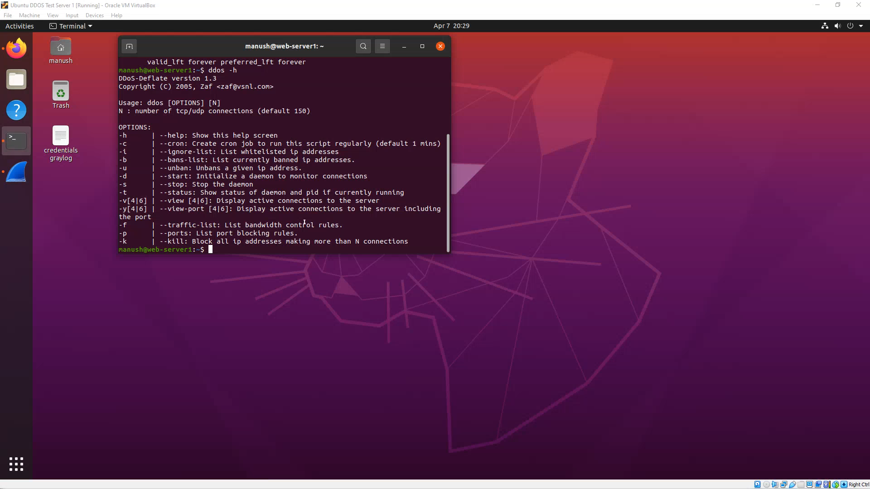
Demonstration Of Attack

Slide 16
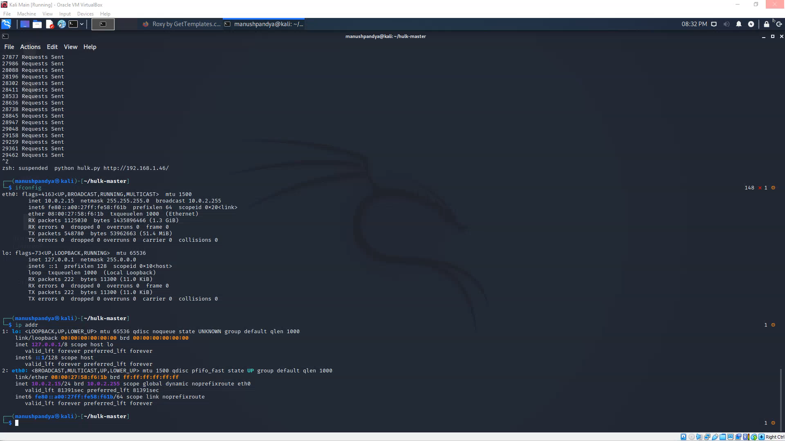
Proof Of Attack Unsuccessful

Slide 17

Analysis the Data using algorithm
Using IBM Watson Machine Learning, we can build analytical models and neural networks, trained with our own data.
We can also deploy models, scripts, and functions, manage our deployments, and prepare our assets to put into production to generate predictions and insights.

Slide 18
AutoAI Model
The Auto AI graphical tool in Watson Studio automatically analyzes your data and generates candidate model pipelines customized for your predictive modeling problem.
These model pipelines are created iteratively as Auto AI analyzes your dataset and discovers data transformations, algorithms, and parameter settings that work best for your problem setting. Results are displayed on a leaderboard, showing the automatically generated model pipelines ranked according to your problem optimization objective

Slide 19
- Created Watson Studio Environment with machine Learning Service for the deployment
- Building and deploying a machine learning model with Auto AI
Basic workflow includes these tasks:
Create a project
Associate the Watson Machine Learning service with the project
Create an Auto AI experiment in the project
Build and train a model
Save a pipeline as a model
Deploy the model
Test the model

Slide 20
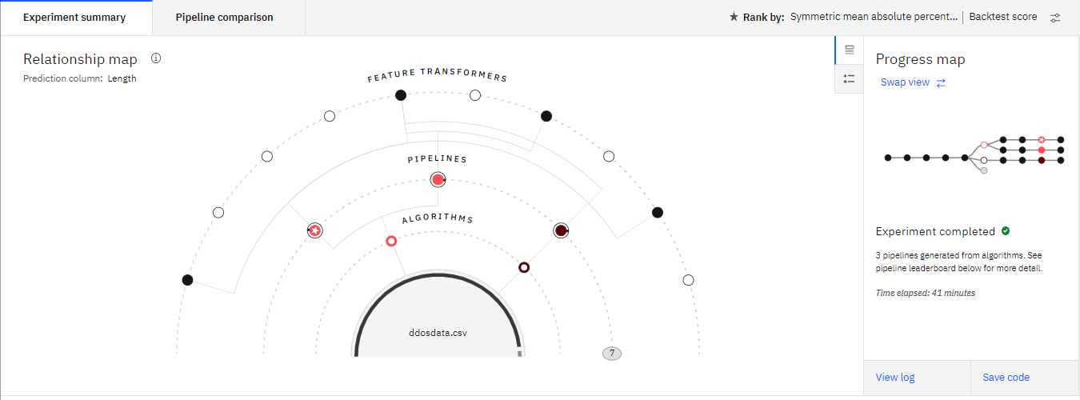
Experiment Summary

Slide 21
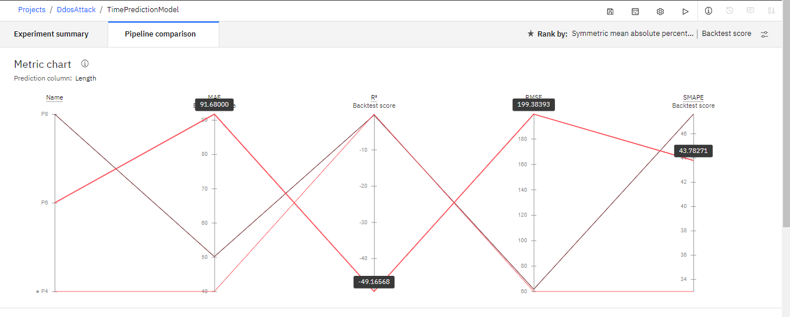
Pipeline Comparison

Slide 22
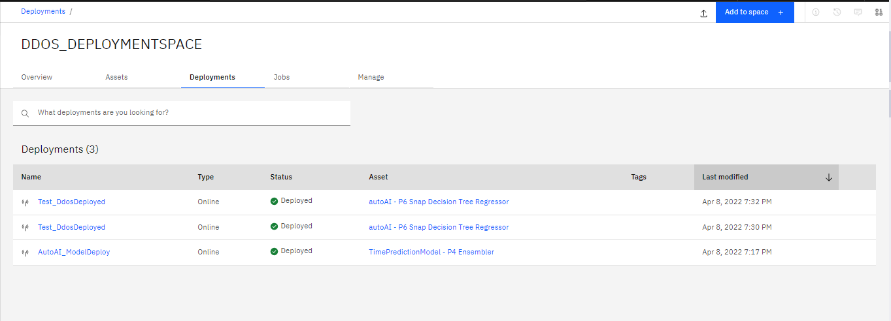
Deployment of Machine Learning Models

Slide 23

Email Alert

Slide 24
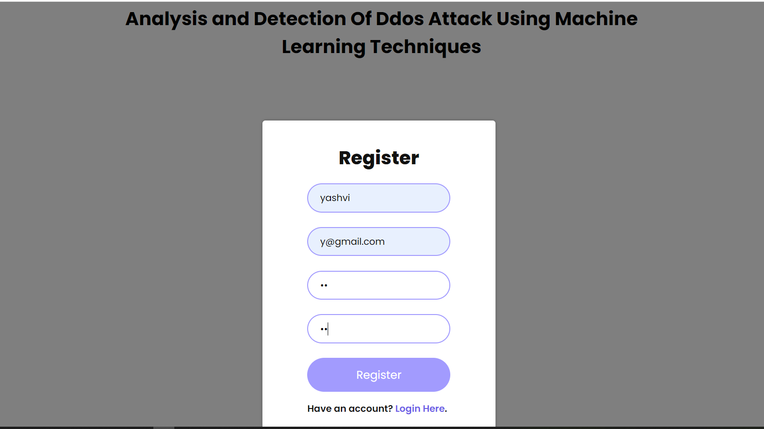
Registration
Frontend

Slide 25
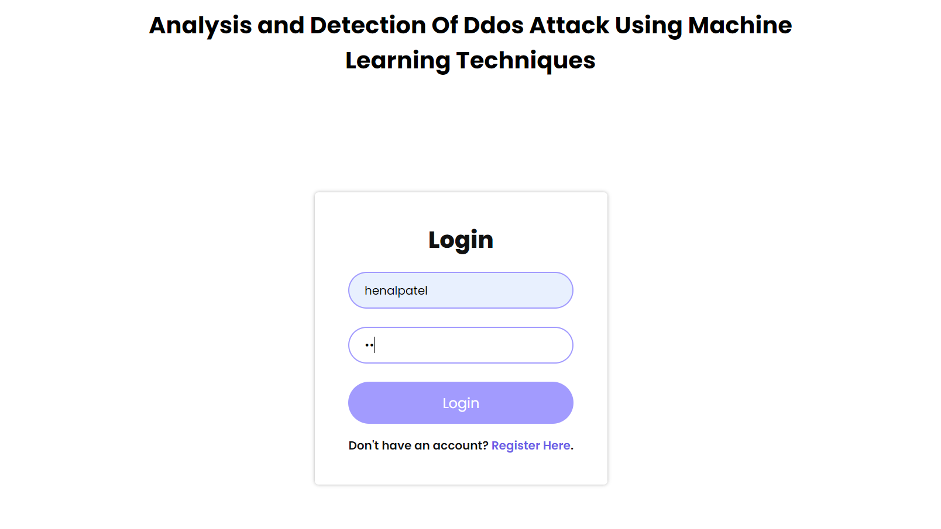
Login Page

Slide 26
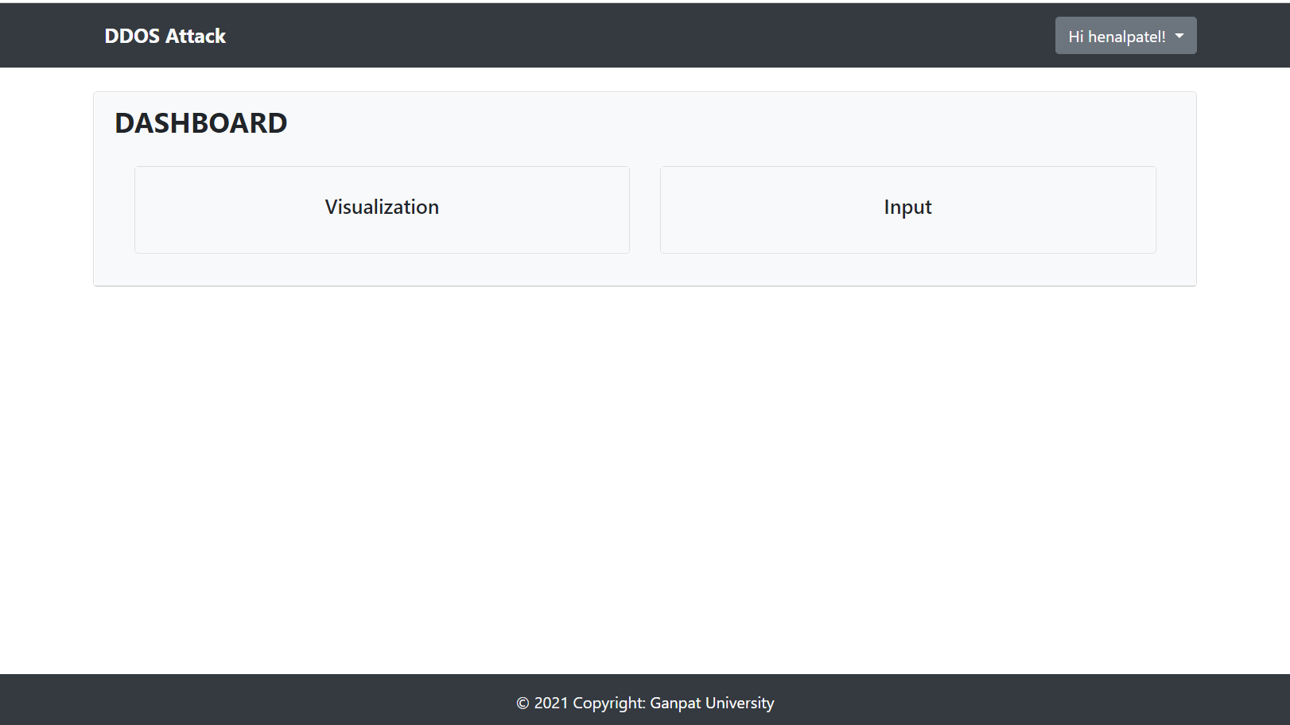
Dashboard

Slide 27
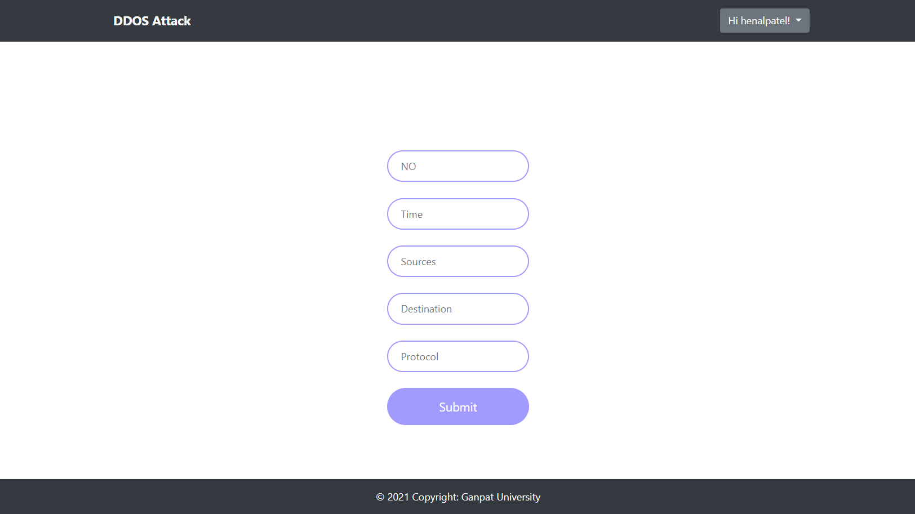
Prediction

Slide 28
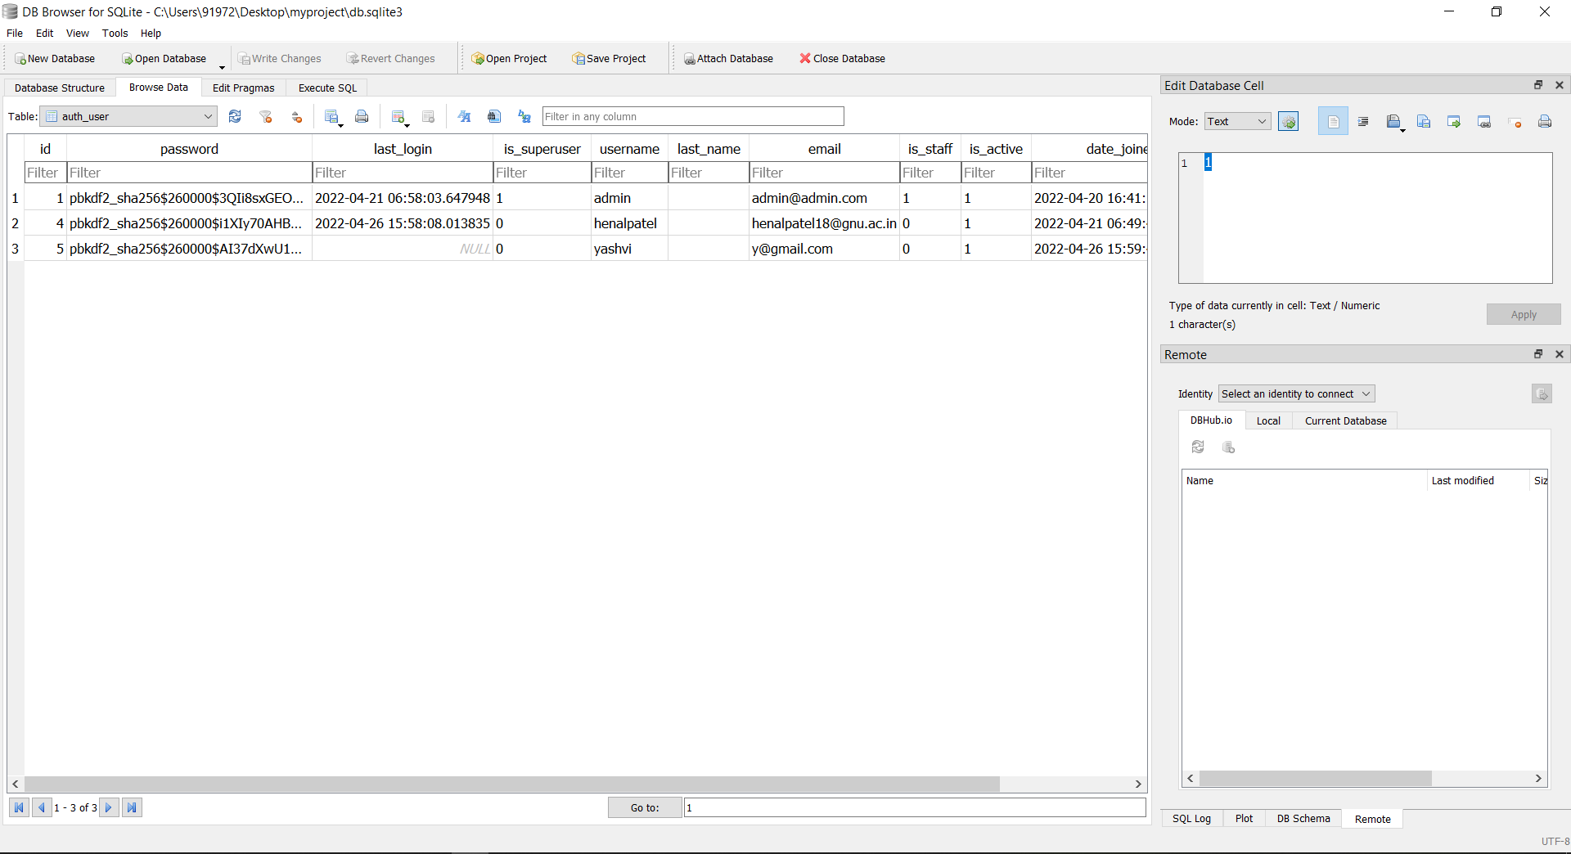
Database

Slide 29
Domain check-up
• DDoS attacks occur as a result of a large number of requests made to the target by bots or infected systems using various ip’s.
• IP reputation, as well as identifying and identifying malicious IPs from genuine IPs, plays an important role in the project.
• IP reputation checker which checks the ip list extracted from the dataset
• The task of dividing malicious IPs and categorizing them into three categories, namely High, Medium, and Low.

Slide 30
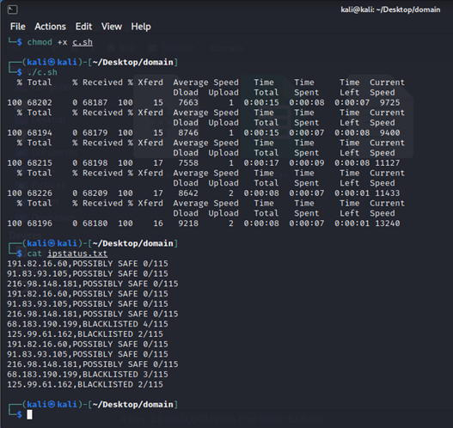
The script begins with the input of a file
containing a list of IP addresses in xlsx format
and then requests with the IPVoid
using curl, which returns the HTML response.
Later script filters out the specific part
that includes the IP Score and saves it in a
new file with the IP address and score, which
can be used as input for the next phase.

Slide 31
Conclusion
As we all know that the ratio of DDoS Attacks has rapidly increased in the last few years. A company needs to protect its service and server infrastructure from such attacks. There are industry tools available that provide optimum ddos protection but more often than not they are very expensive for small business.
Small business don’t have the infrastructure, resources or technical know how to deploy these solutions. In this case open source tools are generally looked forward upon. But open source tools lack the appropriate analysis and detection mechanisms. We plan on improving these solutions with the help of IBM Watson and create a better and more cost effective system that provides moderate DDoS mitigation.

Slide 32
Bibliography
https://www.ibm.com/
https://stackoverflow.com/
https://www.ijeat.org/

Slide 33
Thank You

